Slide 1



Installing Postgres on a
Raspberry PI
By: Lloyd Albin
9/28/2012

Slide 2

Raspberry Pie
We are not talking about a Raspberry Pie

Slide 3

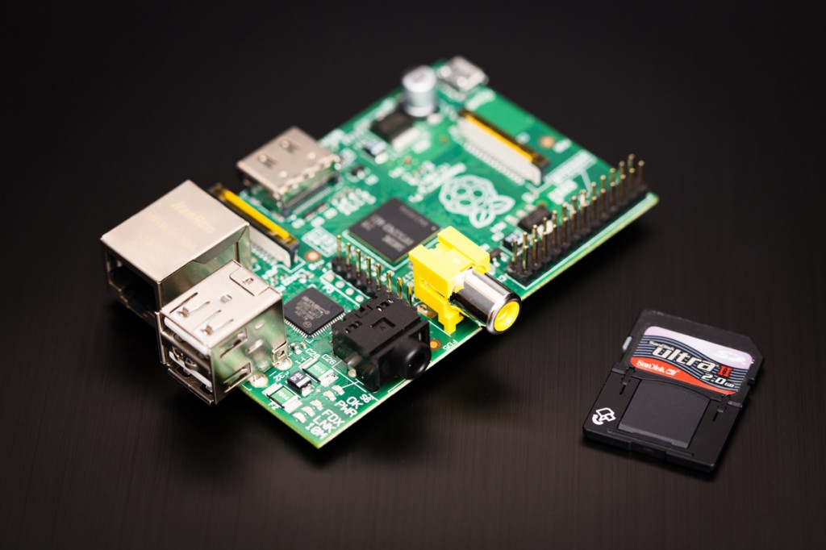
Raspberry PI
A raspberry PI is a credit card sized computer for $35.

Slide 4
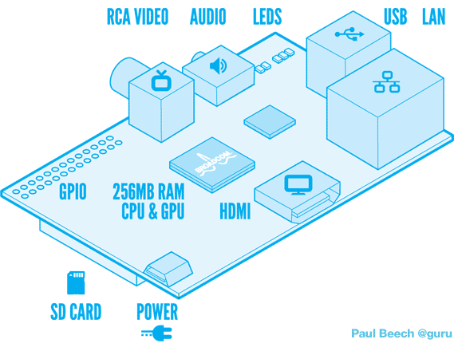
What does it have?
Rev 1: 700 MHz CPU, can be 10% overclocked.

Slide 5
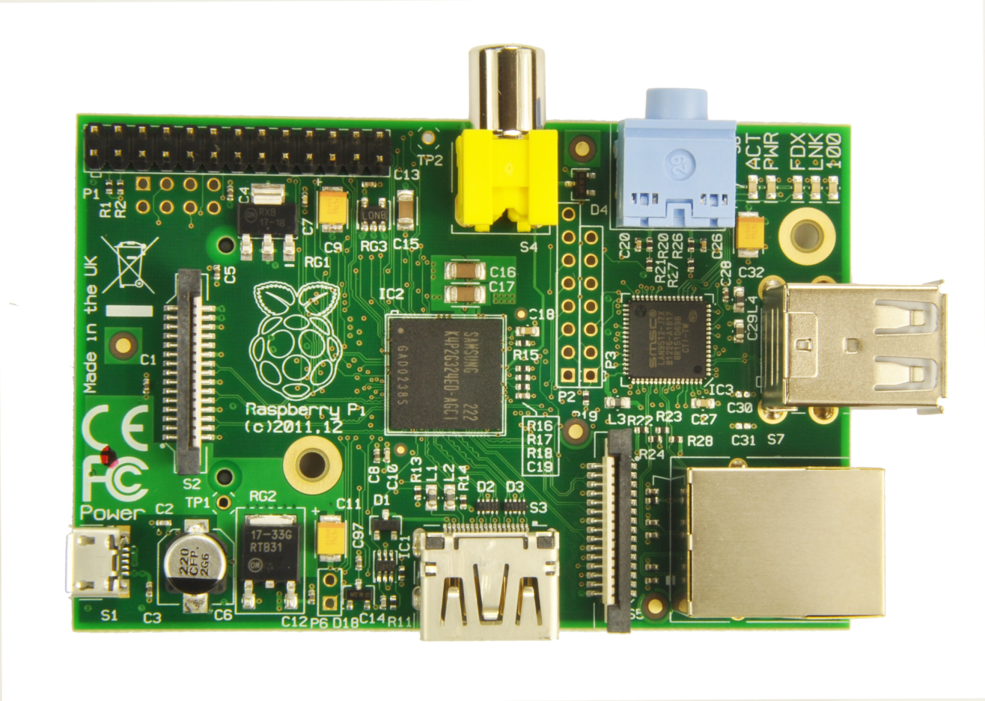
Revision 2
700 MHz CPU, May be overclocked to 1.0 GHz.
Notes:
http://www.raspberrypi.org/archives/1929

Slide 6
Preparing to Install the OS
The easiest way to install an OS is with one of their image files.
http://www.raspberrypi.org/downloads
I downloaded the Raspbian “wheezy’ version. The latest is the 2012-09-18 edition.
You will also need Win32DiskImager (Windows) or dd (Unix) to write the image to your SD card.

Slide 7
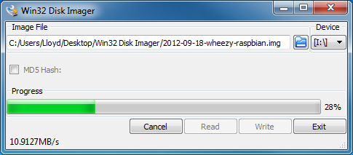
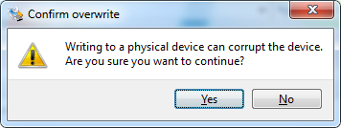
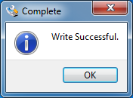
Installing the Raspbian OS
Run Win32DiskImager, select the image, and then click the <Write> button.

Slide 8
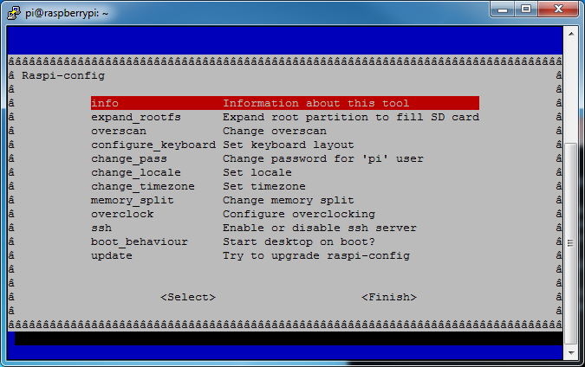
First Bootup
Upon first bootup, you need to do some configuration. Expand the root partition. Optional: enable ssh, startx, change password.
Notes:
If you need to re-run the config later, you can do so:
# sudo raspi-config
Current password is raspberry for the pi user

Slide 9
Updating the OS
For any version of Postgres or PG Admin III, we need to update the OS packages first.
sudo apt-get update
sudo apt-get upgrade

Slide 10
Installing Postgres 9.1
Postgres 9.1 is easy to install. On 10/1/2012 this is Postgres 9.1.5
sudo apt-get install postgresql

Slide 11
Pre-Requisites for Compiling Postgres
sudo apt-get install libperl-dev
sudo apt-get install python-dev
sudo apt-get install libreadline-dev
sudo apt-get install comerr-dev
sudo apt-get install libkrb5-dev
sudo apt-get install libxml2-dev
sudo apt-get install libxslt1-dev
sudo apt-get install libldap-dev
sudo apt-get install gettext
sudo apt-get install tcl-dev
Notes:
apt-cache search msgfmt – really part if gettext

Slide 12
Additional Pre-Requisites
Bison and flex are only needed for compiling Postgres 9.3 or any HEAD release from the git source repository.
sudo apt-get install bison
sudo apt-get install flex
Notes:
The normal source releases are pre-compiled using bison and flex and so they are not needed for those releases.

Slide 13
Downloading Source Code
We can download any of the current versions of source code from:
http://www.postgresql.org/ftp/source/
wget http://ftp.postgresql.org/pub/source/v9.2.1/postgresql-9.2.1.tar.gz
tar -zxf postgresql-9.2.1.tar.gz
cd postgresql-9.2.1
Notes:
gunzip postgresql-9.2.1.tar.gz
tar xf postgresql-9.2.1.tar

Slide 14
Development Source Code Install
Install git
sudo apt-get install git-core
Download the Postgresql git.
git clone git://git.postgresql.org/git/postgresql.git
cd postgresql
Notes:
http://wiki.postgresql.org/wiki/Working_with_Git
http://git.postgresql.org/gitweb/

Slide 15
Configuring from source code
./configure \
--enable-cassert \
--enable-debug \
--enable-nls \
--enable-integer-datetimes \
--with-perl \
--with-python \
--with-tcl \
--with-krb5 \
--with-includes=/usr/include/et \
--with-openssl \
--with-ldap \
--with-libxml \
--with-libxslt
Notes:
./configure --enable-cassert --enable-debug --enable-nls --enable-integer-datetimes --with-perl --with-python --with-tcl --with-krb5 --with-includes=/usr/include/et --with-openssl --with-ldap --with-libxml --with-libxslt
Optional --with-pgport=5433 --prefix=/usr/local/postgres/9.3
11 minutes

Slide 16
Compiling Postgres
To start the build, type:
make
If you want to build everything that can be built, including the documentation (HTML and man pages), and the additional modules (contrib), type instead: (Not valid for git HEAD edition aka 9.3)
make world
It is optional but you can do regression testing of the database before installing it.
make check
Notes:
Compiling from git source code about 2 hours

Slide 17
Installing Postgres
To install PostgreSQL enter:
sudo make install
To install the documentation (HTML and man pages), enter:
sudo make install-docs
If you built the world above, type instead
sudo make install-world

Slide 18
Initializing the Database
Create the Postgres User
sudo adduser postgres
Create the Data directory and assign the correct permissions
sudo mkdir /usr/local/pgsql/data
sudo chown postgres /usr/local/pgsql/data
Change to the Postgres User
su – postgres
Initialize the database
/usr/local/pgsql/bin/initdb -D /usr/local/pgsql/data

Slide 19
Starting the Postgres Server
Success. You can now start the database server using:
/usr/local/pgsql/bin/pg_ctl -D /usr/local/pgsql/data -l logfile start
Note: The above logfile is located in the Postgres home directory.
To Stop the database server:
/usr/local/pgsql/bin/pg_ctl -D /usr/local/pgsql/data stop
Notes:
http://buildfarm.postgresql.org/cgi-bin/show_status.pl

Slide 20
Other things to do
Setup postgres, role, password in Postgres
Start up and shutdown scripts
Modify postgresql.conf
  True logging instead of –l logfile
  Setup to listen on more than localhost
Modify pg_hba.conf
  Allow other computers to access

Slide 21
Installing PG Admin III
sudo apt-get install pgadmin3
You will need to either make a desktop icon for it or launch it from the terminal window within x-windows.
pgadmin3 &

